Slide 1
The Mantid Project The challenges of delivering flexible HPC for novice end users
Nicholas Draper SOS18

Slide 2
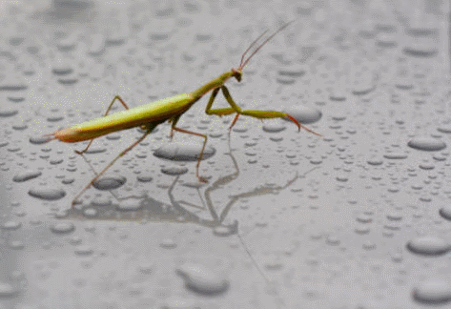
What Is Mantid
A framework that supports high-performance computing and visualisation of scientific data.
Manipulate and analyse Neutron and Muon data.
Neutron Scattering
Diffraction, spectroscopy, small angle, reflectometry
Muon Spectroscopy
Could be applied to other techniques
Open Source
Multiple Platforms
Windows, Linux, Mac

Slide 3

Project History
July 2007 Requirements & Design
April 2008 V 1.0 First instrument support
April 2010 Collaboration with SNS & HFIR
Nov 2012 V2.4 Live Data Reduction
Jan 2014 V3.1 Interest by other major facilities

Slide 4
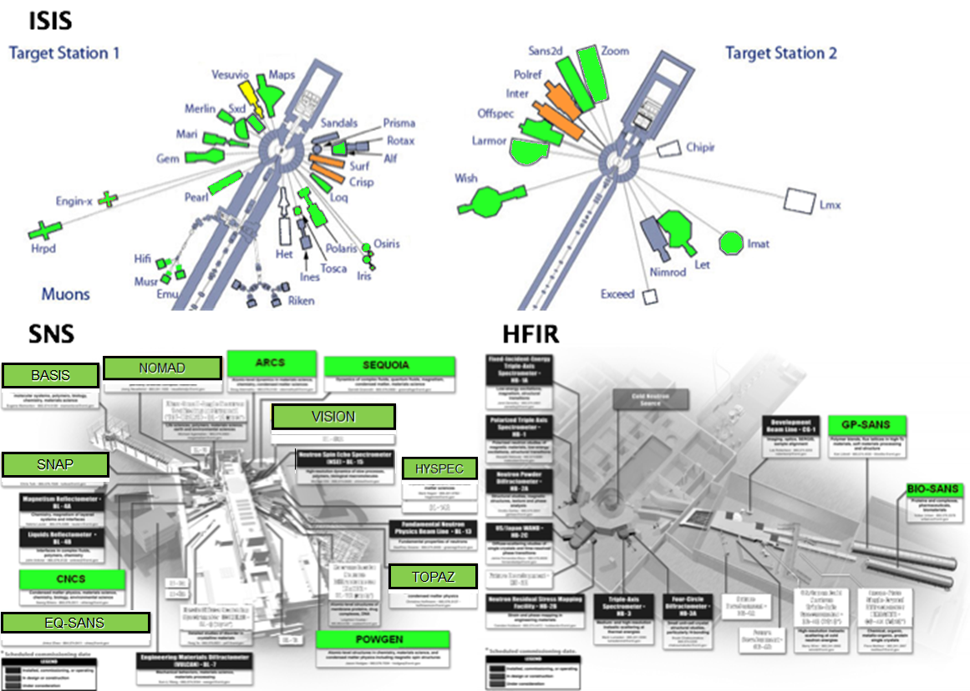
Members

Slide 5




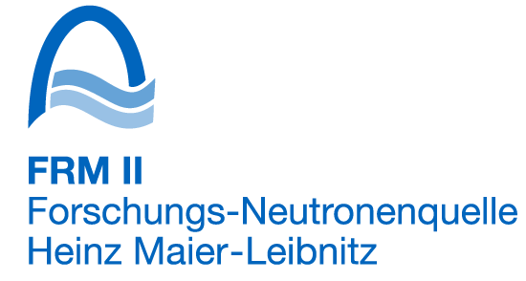

Contributors

Slide 6

Architectural Design - Overview
Instrument log files
Python
Command line & Scripting interface
Mantid Framework
RAW data files
API
Algorithms
Workspaces
MantidPlot Graphing and analysis
NEXUS data files
User Defined
User Defined
DAE direct access
Future Instrument specific UI
Future Instrument specific UI

Slide 7
The Mantid Environment
Users
From scientific experts, who will understand HPC to some extent, but have limited time.
To visiting scientists, who just want results, and have little time to understand systems or learn new processes.
Compute environments
Local computer only
Powerful workstations
Facility HPC facilities
University facilities

Slide 8
Mantid and Distributed Computing
Not all operations in Mantid would benefit from distributed or HPC computing
Small data volume
Large data volume, local to client, simple operations
For some operations the need is clear
Large Data Volume, fast access by cluster
Complex scalable operations
Monte Carlo instrument simulations
Absorption corrections
Use of third party codes
Molecular dynamics simulations
Computationally expensive optimisations of models to experimental data

Slide 9
What is a Mantid job?
Input data
Shared File Location
Uploaded File
Python Script
Output data
Shared File Location
Downloaded File

Slide 10
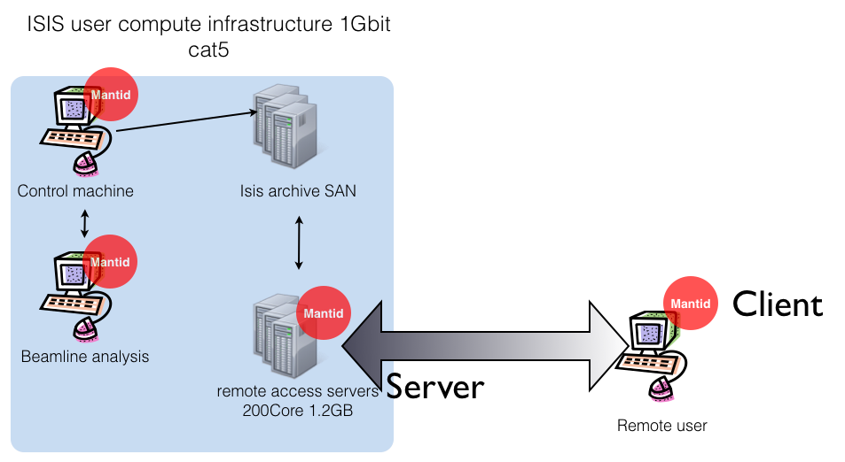
One possible Infrastructure

Slide 11
Challenges
Different facility infrastructures
Authentication
Username/password, certificates, need to physically turn up with ID.
Job Schedulers
Few accessible via web services
Of those that do not few work well with C++ cross platform
Locating resources

Slide 12
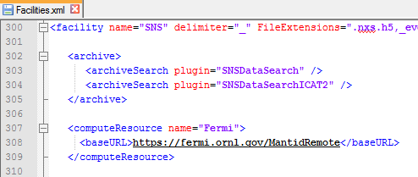
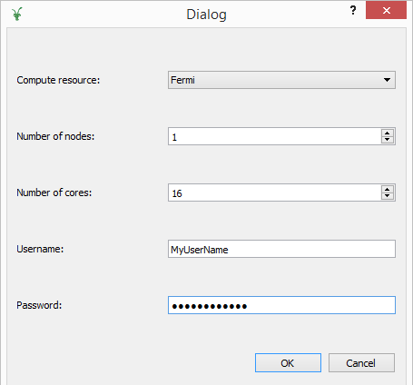
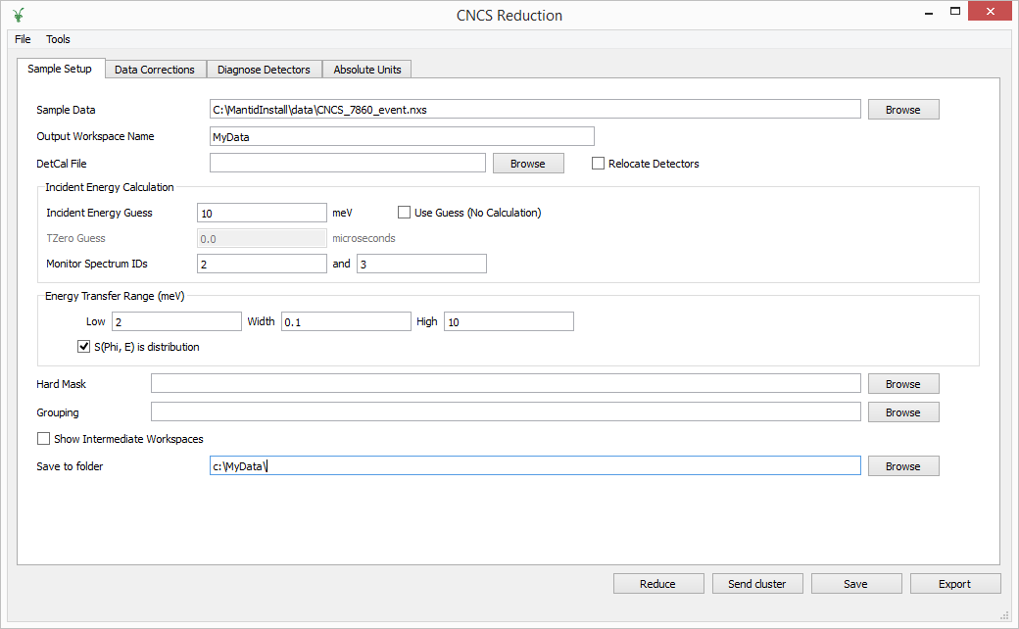
Interfaces - Keep it simple

Slide 13
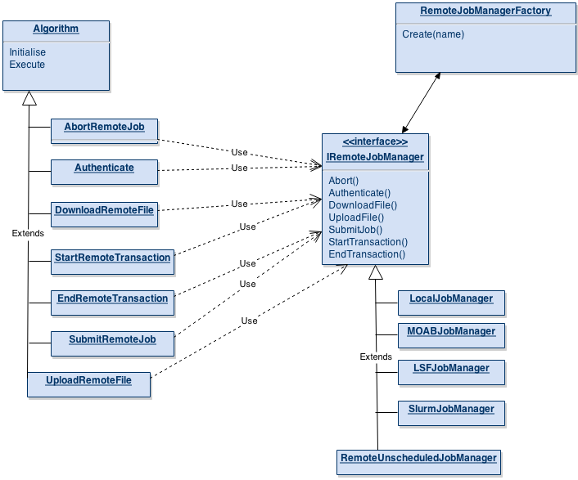
Under the bonnet
Mantid Specific
General Use

Slide 14
The Ideal Middleware
Removes the need to care what job scheduler is in use.
Compiles easily on Windows, Mac, Linux
Packages easily for deployment
APIs
C++, Python
others
Needs to handle network proxies, firewalls etc
Does not need Admin or special permissions
Easy to add additional Job Managers
Just works …

Slide 15

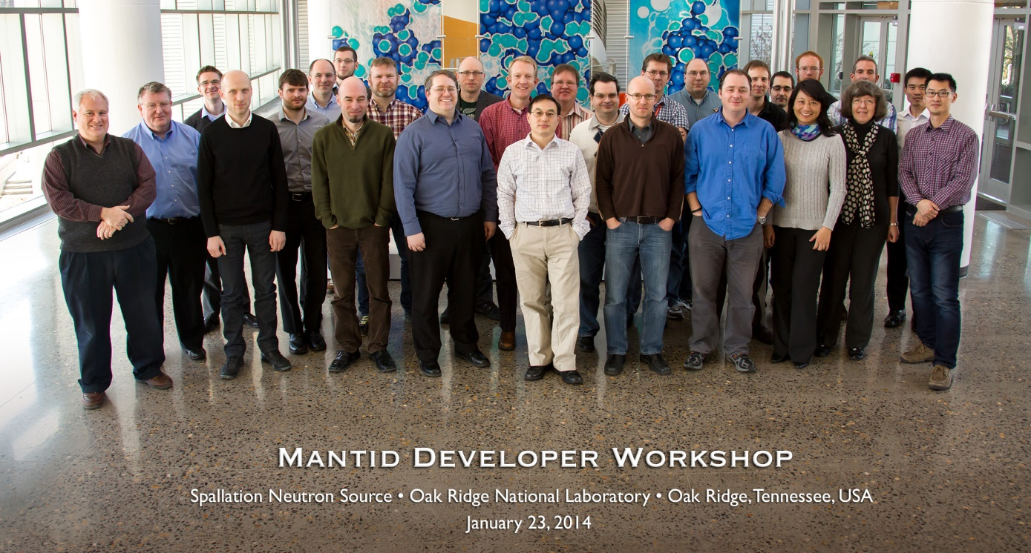

Further information
Project web page - www.mantidproject.org
Many Thanks to the Project Sponsors
And the development team

